Slide 1
EMPLOYEES AND EMPLOYMENT TRENDS MPU3362 & VC1
IDENTIFY SELF STRENGTH

Slide 2
CLASS RULES
PLEASE BE PUNCTUAL
For online classes, you must ‘on’ the audio & camera whenever you speak
When you are not speaking, please mute your audio and off the camera.
Please use the chat option to communicate with lecturer and classmates whenever required
Participate actively during class.
Ensure you have scanned your attendance.
Always check your Microsoft Teams for any updates.

Slide 3
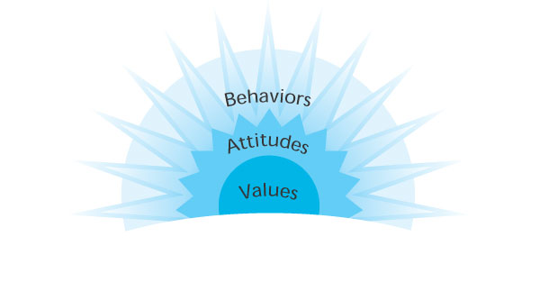
Re-Cap Previous Lesson
Attitude is Altitude
Individuals have power to choose attitudes.

Slide 4
Topic & Structure of The Lesson
Definition
Why is it important
Identify self strengths
The strength-based assessment

Slide 5
Learning Outcomes
At the end of this topic, You should be able to
Describe the materials and components of self strength
Recognise and identify a person’s strengths
Discuss on the important self strength

Slide 6
Key Terms You Must Be Able To Use
If you have mastered this topic, you should be able to use the following terms correctly in your assignments and exams:
Self Strength
Talent
Skills
Questionnaire
Self-Reflection

Slide 7
Let’s understand self-strength
https://youtu.be/8jhcxOhIMAQ

Slide 8
Brainstorm
If you were to create a word cloud to show an employer your greatest strengths, what would it say?

Slide 9
What are strengths?
A particular way of processing information that your brain is good at.
Consistent near-perfect performance in an activity.
A part of your brain that’s more efficient than other parts.
An activity that makes you feel strong.
A combination of talents, skills and knowledge that are consistently and productively applied to achieve a desired result.

Slide 10
There are 3 raw materials of strengths:
• Talents
• Knowledge
• Skills

Slide 11
Cont…
T A L E N T S
A talent is a naturally recurring pattern of thought, feeling, or behavior.
Talents endure because they were “hardwired” into your brain.
K N O W L E D G E
Knowledge is a mix of facts and lessons you’ve learned.
Factual knowledge won’t guarantee excellence, but excellence is impossible without it.
S K I L L S
The ability to do something well.
Skills are generally developed through a combination of practice and aptitude.

Slide 12
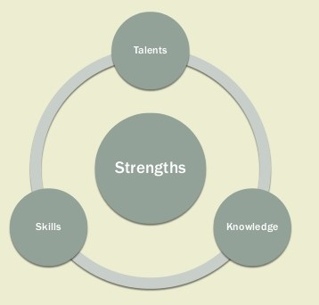
The key to building your strengths is to identify your dominant talents and then refine them with knowledge and skills. Strengths Talents Knowledge Skills

Slide 13
Why is it important to identify your strengths?
❖ Sets you apart from everyone else
❖ Leads to greater personal and professional development
❖ Improves effectiveness
❖ Makes your life more productive and fulfilled
❖ Helps you experience a feeling of “rightness”

Slide 14
How can you identify your strengths?
1. Questionnaires
2. Self Reflection

Slide 15
Questionnaires
❖ Help you dig into personal insights
❖ Give a better understanding and description of your values
❖ Let you know what kind of work environment you will enjoy and excel in
❖ Show you how you can enhance your strengths and develop your weaknesses

Slide 16
Self Reflection
A sure way to identify your strengths and talents is stepping back and watching yourself for a while.
4 clues to identify your strengths through self reflection:
Spontaneous Reactions
-How do you react to situations you encounter?
2. Yearnings
-What strong connections keep calling out to you?
-What activities do you want to repeat?
3. Rapid Learning
-What do you learn more quickly than other people?
-What do you have a desire to learn more about?
4. Satisfactions
-What activities do you feel good about?

Slide 17
Use the SIGN Method: Self Reflection
Success
❖ Using your strengths makes you feel successful
Instinct
❖ Activities you are naturally drawn to
Growth
❖ Where you learn the most, come up with new ideas, and have the best insights
Needs
❖ Where you feel the need to spend the most time

Slide 18
Self Reflection Bonus! :
Use others to find your strengths
❖ What do others ask for your help with?
❖ What do others want you to teach them?
❖ What do you receive compliments for?
❖ Simple but effective: just ask family, friends, and coworkers what they think you’re good at!

Slide 19


Slide 20
STRENGTH BASED ASSESSMENT
6 essential components of strength identification
1. Performing it in a context that makes sense for the person
2. Conducting it as an open discussion (not as an interrogation)
3. Following the person’s rhythm
4. Continuous updating
5. Using the person’s words
6. Complete and specific

Slide 21
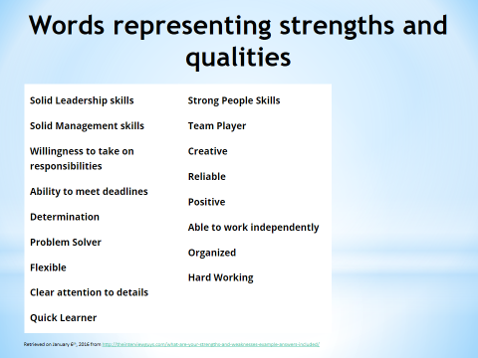

Slide 22
What are your strengths and weaknesses?
If you find yourself in a situation where the interviewer asks you this question, make sure to always start with your weaknesses and end with your strengths.
You want to leave a good taste in the hiring manager's mouth, so make sure the last thing you say in your response is something that leaves you in a positive light.

Slide 23

https://www.viacharacter.org/survey/account/register

Slide 24
Don’t ignore your weaknesses…
Identify them
2. Outsource them
3. Systematize them
4. Minimize them
5. Improve them Manage them!

Slide 25
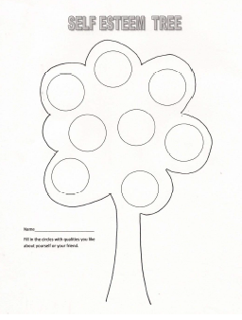
TUTORIAL ACTIVITY:

Slide 26
Summary of Main Teaching Points
Self strength are combination of talent, skills and knowledge.

Slide 27
Question and Answer Session
Q & A

Slide 28
What we will cover next
Self Image & Self Brands

